Slide 1

Cluster Service Health Monitor
Program Design Purpose
We want to create a monitor system which can show customer the services availability of a mid size cluster in real time. The program can check the availability/execution state of each nodes/vms/services/programs in the cluster regularly and provide the system health evaluation scores based on user's pre-set calculation function. We aim to avoid the user making much change of their routing config of the switches in the network or installing much additional libs on their nodes during the setup process to reduce the complexity of deployment. The system can be applied to the below scenario:
Monitor the health of the critical nodes/services used in a cyber exercise.
Monitor whether some attacks are happening or has happened on some critical nodes (such as NTP server)/service program of a cluster.
Visualize the nodes' status change/modification during a cyber security drill/events.

Slide 2
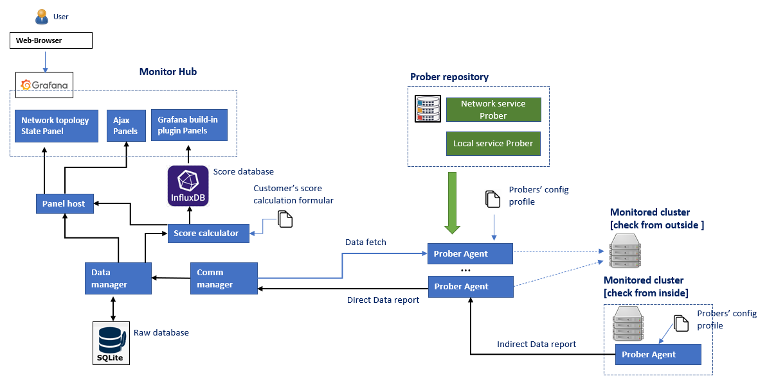
Cluster Service Health Monitor
Introduction
The Cluster Service Heath Monitor is a system function/service monitoring program to check and evaluate the cyber security computing cluster's critical points (node, service, function, file system) availability in real time during the cyber exercise. The system contents three main parts and the system workflow diagram is shown below:
Service Prober Repository : A service checking lib with several different prober functions (such as check NTP, FTP, VNC, ssh ...) to detect whether a specific node / service / program / function is working normally.
Prober Agent : A agent collects and schedules several different kinds of probers to check the entire availably of one or multiple targets’ working state in the cluster.
Monitor Hub : A data visualization and analysis system provides database to archive data, a web-based dashboard for user to check the monitored cluster's state and the interface for user to plug in their score calculation formular / function are also provided.
System Workflow Diagram

Slide 3
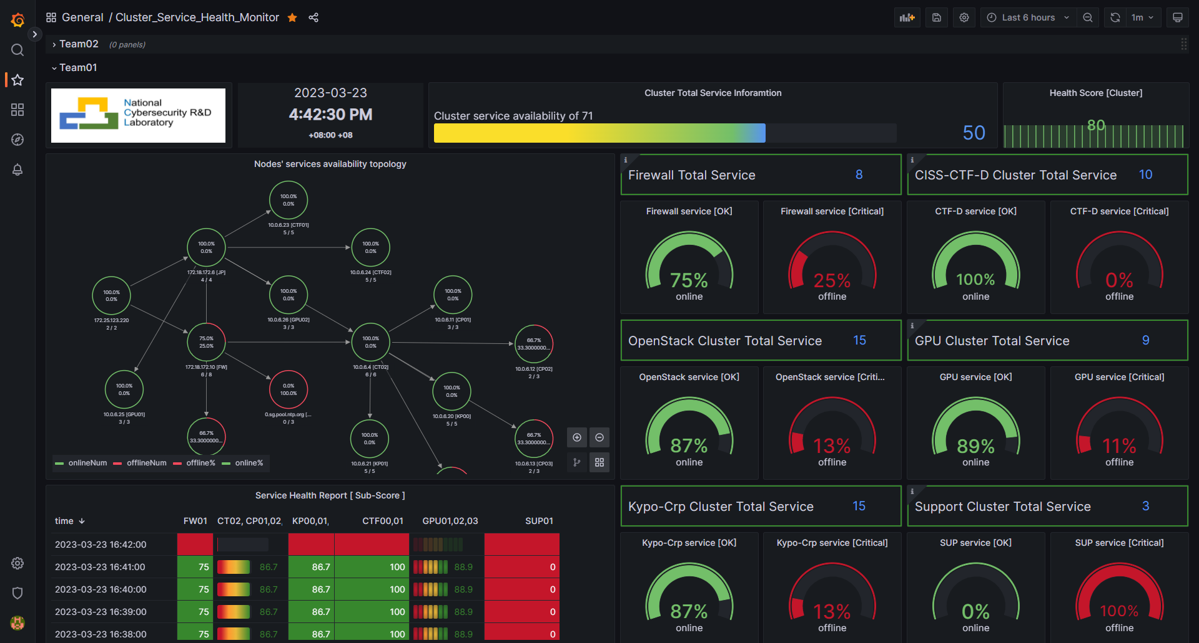
Cluster Service Health Monitor [Score dashboard]
A sample template of the score monitor dashboard:
The cluster’s network topology and the service health of each monitored node/sub-cluster
The online and total service monitored count
Current service score and the score history diagram
Teams/Cluster selection drop down menu.
Service health percentage categorized by services type.
Score history
table of every sub-service cluster.

Slide 4
Cluster Service Health Monitor [ Service Prober Repository ]
Introduction
Service Prober Repository is a prober module lib to provide the service / program function check function. The prober function can be categorized to three parts: local service probers, children agent prober and network serice probers.
Local service prober : The local service prober will run inside the target node to monitor the nodes resource usage (CPU%, Memory, Hard disk, user), network state (port opened, connection, NIC I/O state), local program execution state (process) and file system modification. The probers details are shown below:
Network Service prober: The service prober run outside the target nodes to check the node's services state through network. The probe functions provided are shown below:
Prober Name | Probe action/ service covered
Server active Prober | ICMP (ping), SSH(login), RDP, VNC, X11/X11:1-Win
Service ports prober | Use a customized Nmap lib check whether the node's request service ports are opened.
Service function prober | NTP service prober : Check the NTP service latency and time offset correctness.
 | DNS/NS service prober: Check the dns service name mapping correct.
 | DHCP service prober: Check the dhcp broadcast.
 | FTP service prober : Whether can login the FTP server and list the directory tree.
 | Http/https web prober: Check the webserver can handle request correctly
 | Email service prober: Check whether the email server is working normally
 | TCP/UDP service prober: Service use TCP/UDP connection. (such as MS-Teams, Skype service)
 | Database service prober: Check the database connection
Prober Name | Probe action/ service covered
Resource usage Prober | CPU %, Memory %, Hard Disk %, Network Bandwidth Usage.
User action Prober | User login, cmd executed, file system modification.
Program action prober | Program execution, process started, service port opened, program log check.
Children Agent prober : A prober to fetch data from other prober agent program and merge the data. This prober is used for link the subnets which only linked with jump host without set routing table.

Slide 5
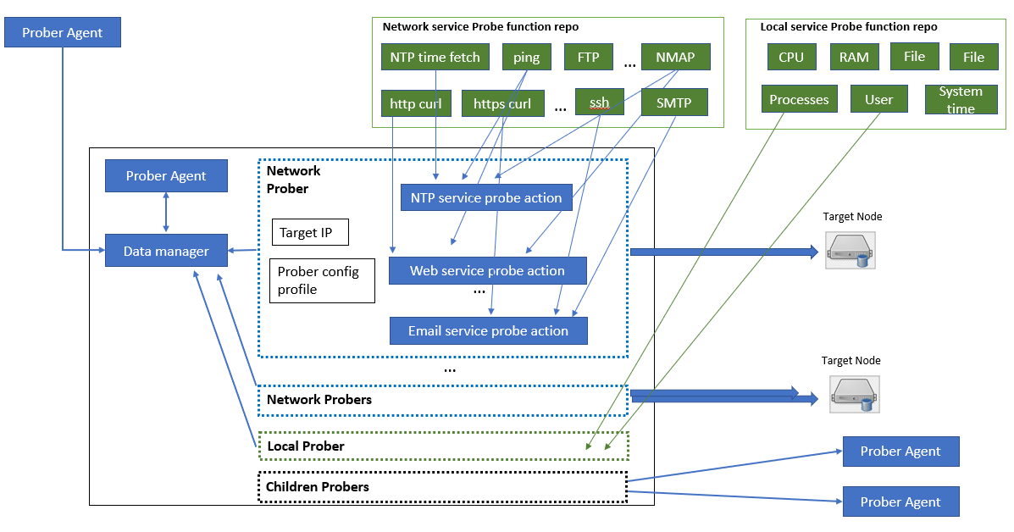
Cluster Service Health Monitor [ Prober Agent ]
Introduction
An agent program collects and schedules several different kinds of probers based on the customized config profile to check the entire service availably of a small cluster. The prober agent provides below 5 main features:
Configuration base on profile : User can easily use their customized profile to config all probers’ execution timeline.
Probing from outside/Inside : Agent can run inside the critical node to check the node's local state or run outside in a node to check the service interface of multiple nodes. So, the customer can deploy the agents based on his monitor priority instead of deploying agent to every node.
Customized prober plugin : It also provides the interface for customer to plugin their customized probe function for specific service (such as a check a billing server).
Data report bus: To avoid changing the original routing config of a cluster, a prober agent can also fetch data from the other touchable prober agents to build a data translation bus/chain to make the deployment easier.
Multiple connection protocol : The agent provide different network protocol for data fetch/report (TCP, UDP, HTTP, HTTPS) to fit for the network traffic limitation requirement in a cyber exercise.
The workflow Diagram of prober agent and relationship between Service Prober Repository and prober agent:

Slide 6
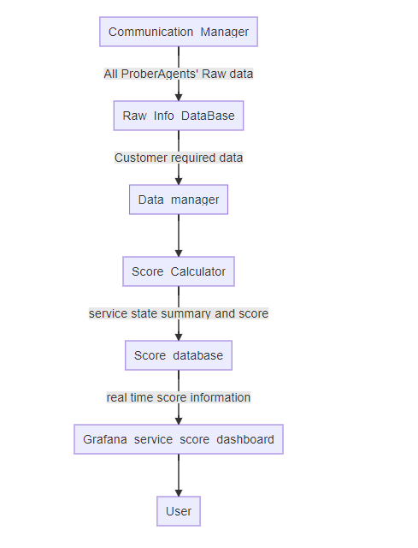
Cluster Service Health Monitor [ Monitor Hub ]
Introduction
The monitor hub is a data processing, analysis and visualization system. All the prober agents will report their monitor result to the monitor hub via communication manager. The monitor hub provides a web-based dashboard (currently we are using Grafana) for users to check the monitored cluster's state, a topology diagram to show the clusters’ services online state and it also provides the interface for user to plug in their score calculation formular/function. The data flow diagram is shown on the right side.
Two data bases will be included in the program:
Raw info database: A database used to archive all the collected service data.
Score database: A database save all the data need to be visualized in the score database.
The data manager will fetch needed data from Raw-Info-DB, process and analysis the raw data and calculate the service core based on customer's score calculation function, then insert/update the data in score database.

Slide 7
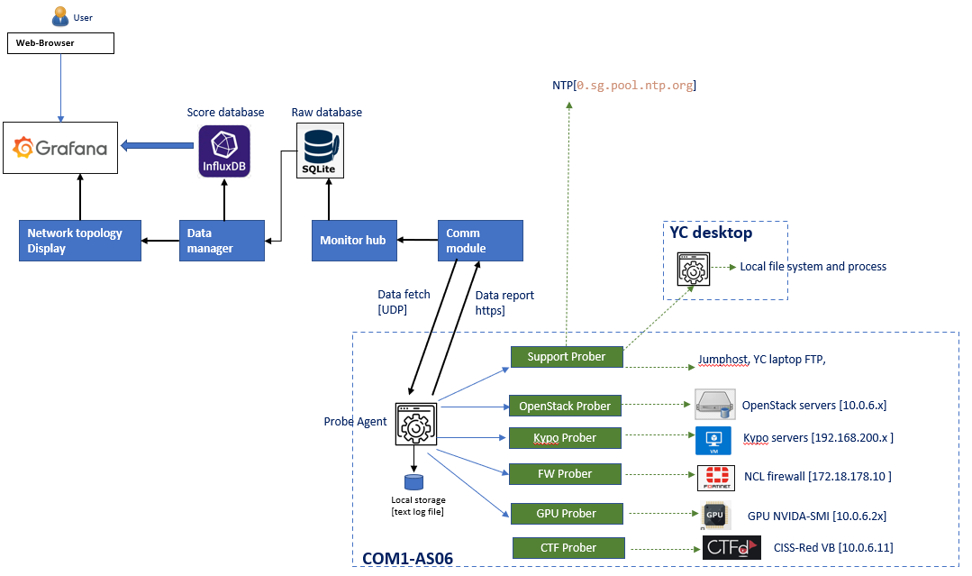
Cluster Service Health Monitor [ Use Case]
Introduction
The Cluster Service Heath Monitor has been deployed on the NCL's AS-06 cluster to monitor 17 nodes with 71 services. In the Cluster we have Openstack cluster, Kypo-Crp cluster, CTF cluster and GPU cluster, the monitored detail is shown below:
System Deployment Diagram :
Probed target service cluster | Physical Node number | Service checked
Firewall [Fortinet] | 1 | icmp, ssh, http-alt, http-proxy, ident, blackice-icecap, http, https
Openstack [CT/CP] | 4 | icmp, ssh, http-alt, upnp, mysql, https, vnc
Kypo-Crp [Jump, K8s] | 3 | icmp, ssh, https, vnc, X11, X11:1-Win
CTF [CTF-D, virtual box] | 2 | icmp, ssh, http, vnc, X11, X11:1-Win
GPU [Nvidia-smi] | 3 | icmp, ssh, vnc, Nvidia-smi
Support | 4 | NTP, ftp, file.

Slide 8
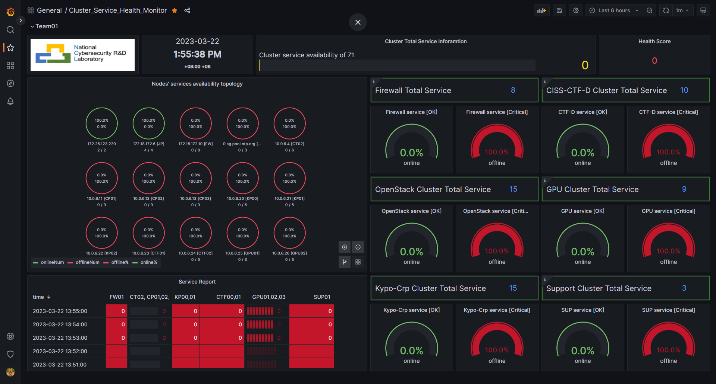
Cluster Service Health Monitor [ Use Case]
The Cluster Service Heath Monitor has been deployed on the NCL's AS-06 cluster to monitor 17 nodes with 71 services as shown below:
Service monitor dashboard [init state]:

Slide 9
Cluster Service Health Monitor [ Use Case]
Service monitor dashboard [life data]:

